Slide 1
Tele manipulator Robot

Slide 2
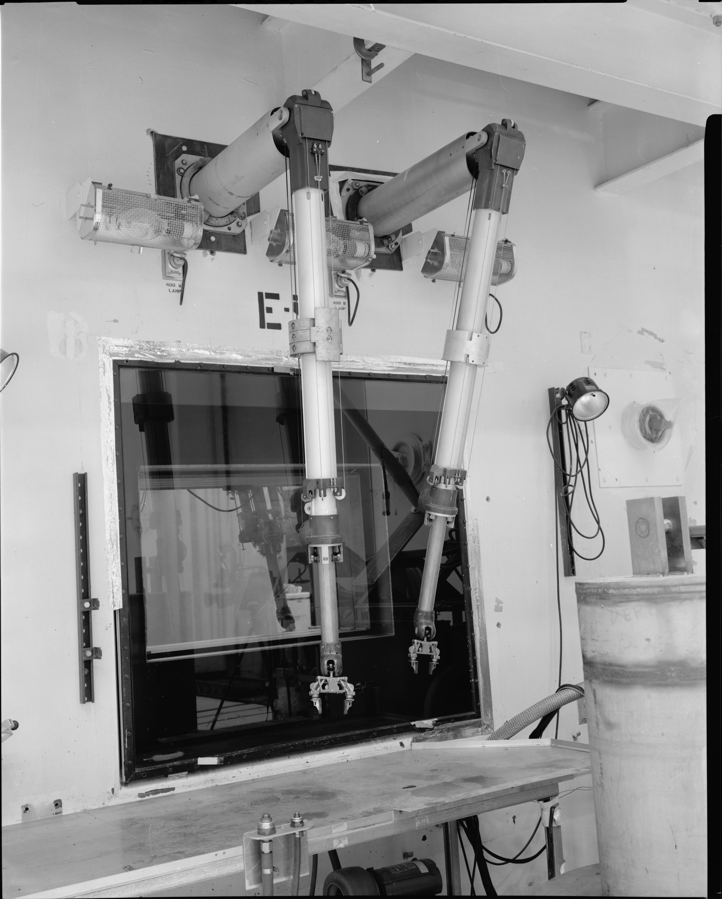
Introduction
Historical Background
In 1945, the company Central Research Laboratories was given the contract to develop a remote manipulator or tele manipulator for the Argonne National Laboratory. The intent was to replace devices which manipulated highly radioactive materials from above a sealed chamber or hot cell, with a mechanism which operated through the side wall of the chamber, allowing a researcher to stand normally while working.
Tele manipulator is a device which allows mechanism to be controlled by a human operator through electronic, hydraulic, or mechanical linkages, allows a hand-like. The purpose of such a device is usually to move or manipulate hazardous materials for reasons of safety, similar to the operation and play of a claw crane game.

Slide 3
Overview
#1 Physical Design for various applications
#2 Actuators
#3 Control System
#4 Data Collection and Transmission
#5 Power Management System

Slide 4
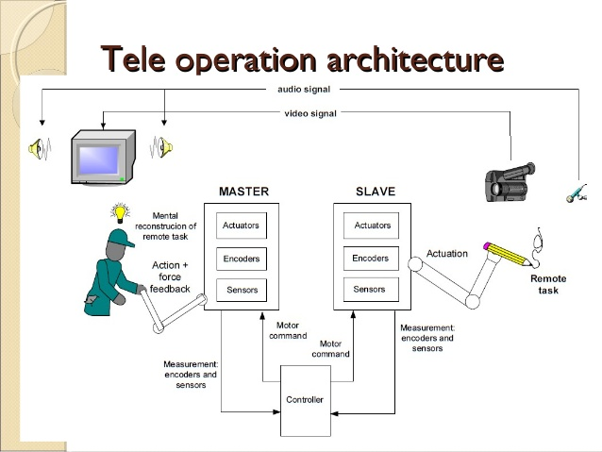
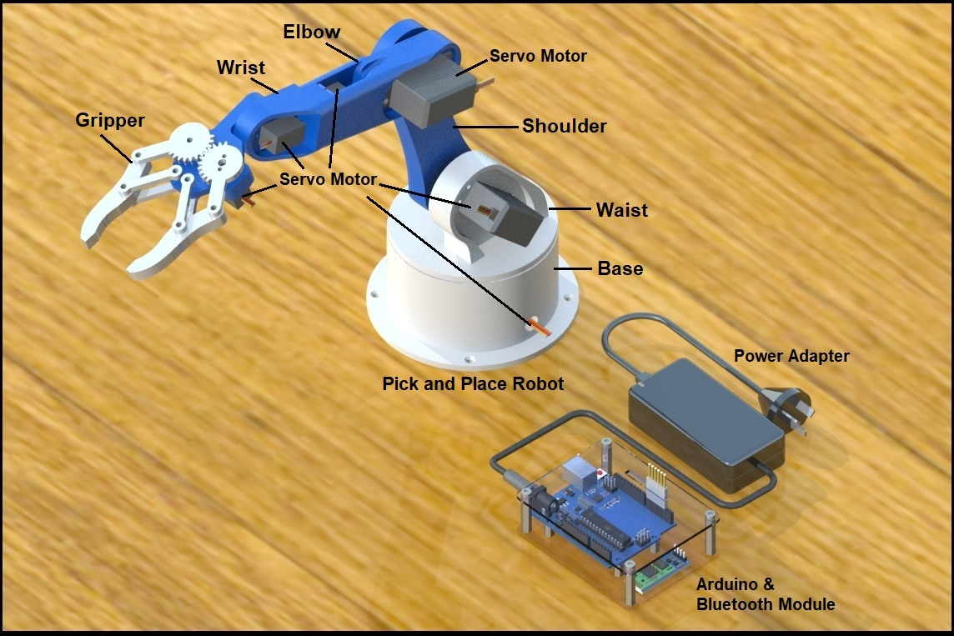
System Architecture Overview

Slide 5
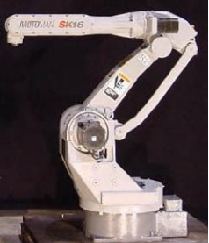
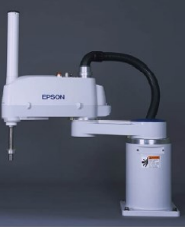
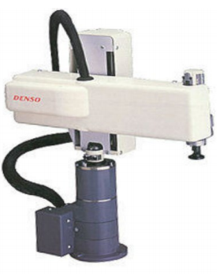
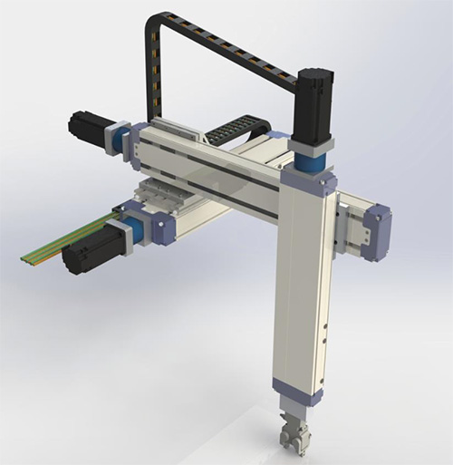
Physical Design for Various Applications
SCARA: It is a 4-DOF robot with RRP joints and is specially designed for assembly operations. The structure allows for precise work and quick assembly or packaging.
Cylindrical: This 4-DOF robot has RPP joints. Its rigid structure allows use for large payloads and good repeatability.
Cartesian: This robot has the ability to move its gripper to any position within the cube or cuboid workspace. The joints are all of prismatic type. It is useful for CNC milling, transfer of materials, and table-top assembly.
Articulated: This robot consists all joints that are revolute and has large freedom. It can range from simple two-jointed structures to systems with 10 or more interacting joints.

Slide 6
Actuators
Tele manipulator Robots can be powered by electric, hydraulic or pneumatic system.
Hydraulic and pneumatic systems are used for high payloads. In between them, pneumatic system is used for faster operations compared to hydraulic system.
Meanwhile, hydraulic system has the when dealing with leaks because it is easy to identify oil or water dripping from a leaked hydraulic system.
For electric actuators, servo is widely used due to high accuracy and precision compared to motors. Servo with controlled feedback loop is also popular such as dynamixel servo.
Dynamixel servo can save the positions of the robot into an address. This makes it easy for you to move the robot to a certain location instantly.
Gears and conveyor belts are used to alternate and transfer the torque.

Slide 7
Actuators
Tele manipulator Robots can be powered by electric, hydraulic or pneumatic system.
Torque capacity is tested at the weakest position (fully extended). From there, we can decide the suitable servo. The servo at the shoulder must be the strongest with largest torque.
The end-effector part detachable. Tools such as a drill, welding tool and milling tool are attached when needed.
The servos are attached on the side of the joints.
Smart servo shield or motor drivers are required to move the actuators in both clockwise and anti-clockwise direction.

Slide 8
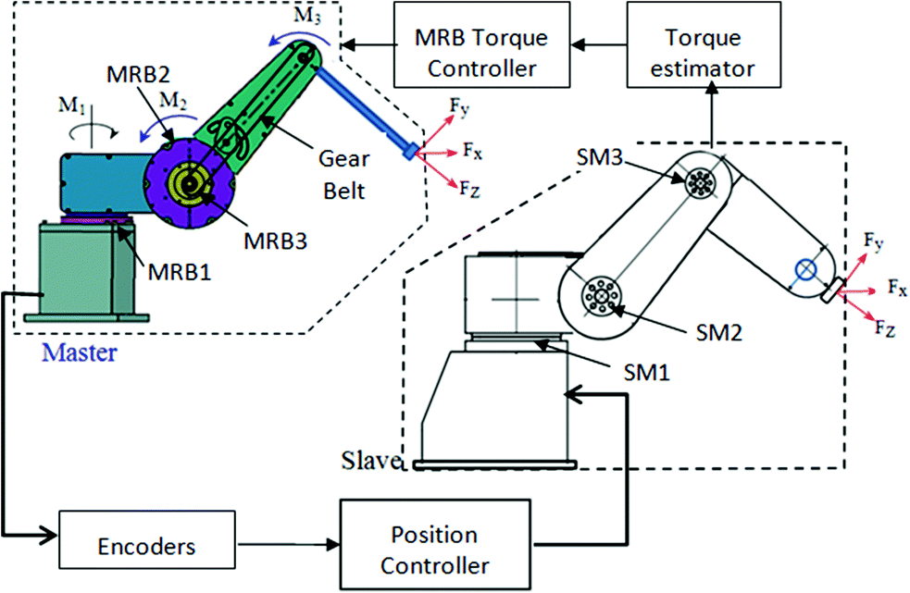
Control System
Torque controller, position controller and eliminating error of the output.
When input is given, the robot acts to satisfy the input.
The controllers react if there is any error available in the output.
Servo actuators are all connected to the master controller (e.g. Arduino board and servo driver) to input position and speed.
In order to avoid robot being entangled with the wires, we use slip rings.
Robot destinations are saved initially to ensure it can execute the commands efficiently.
Each servo is connected to a distinct input pin to enable control of each joints separately.
The robots are also trained with deep learning data to reach the desired output.

Slide 9
Data Collection and Transmission
There are several types of tele manipulator robots that requires data collection and transmission to work effectively and efficiently. From a wireless to an automated tele manipulator type, the detail is actually plenty to talk about. However, we focus on a few of them:
The da Vinci vision system delivers 3D high-definition views, giving your surgeon a crystal clear view of the surgical area that is magnified 10 times to what the human eye sees. This is crucial for any tele manipulator robots that require extra vision to sense defects. It can also work with CT scans and deep neural network.
Some robots uses Near Infrared Technology with indocyanine green. This imaging technology provides real-time feedback that improves precision and decision-making. It also works with guidance from identification of key landmarks as this technology can measure distance.
For wireless robots, it requires receiver and transmitter. The receiver is placed at the robot meanwhile the transmitter is placed at the control panel or the human operator. The decision to make is what interface is suitable for use whether Bluetooth, Wi-Fi or Radio Frequency

Slide 10
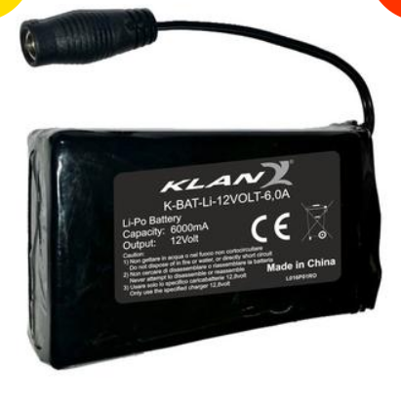
Power Management System
Power required to operate the robot effectively and efficiently.
Electrical tele manipulator robot requires the least power to operate in comparison to pneumatic and hydraulic robotic systems.
Depending on the current required by each servo, the power supply must be able to cover all of them.
For example, if 4 dynamixel servos are used, and it functions optimally at 12V and 1.5A for each servo, then power supply must have at least 12V and 6A supply.
To be safer, the power supply should be higher than the mentioned values, but not too high.

Slide 11
Hardware List
ITEMS | LINK
12V 6A Lipo Battery | https://www.motostorm.it/en/clothing/underwear/macna-li-po-12v-6a-single-battery.html?currency=USD&size=UNICA&gclid=CjwKCAjwhYOFBhBkEiwASF3KGdQqdaC93WYe-zQG0cH6y7N0KXVfrN_0UjomQHniW1RrqDXJkqVf1RoCUBsQAvD_BwE
Dynamixel AX-12A Servo | https://www.robotis.us/dynamixel-ax-12a/
Arduino Uno Board | https://my.cytron.io/
Smart Servo Shield | https://www.bananarobotics.com/shop/DFRobot-Smart-Servo-Arduino-Shield
Wireless RF Transmission Module | https://my.cytron.io/
RF Transceiver | https://my.cytron.io/
3D Printer 1.75mm PLA Filament (Black) | https://my.cytron.io/

Slide 12
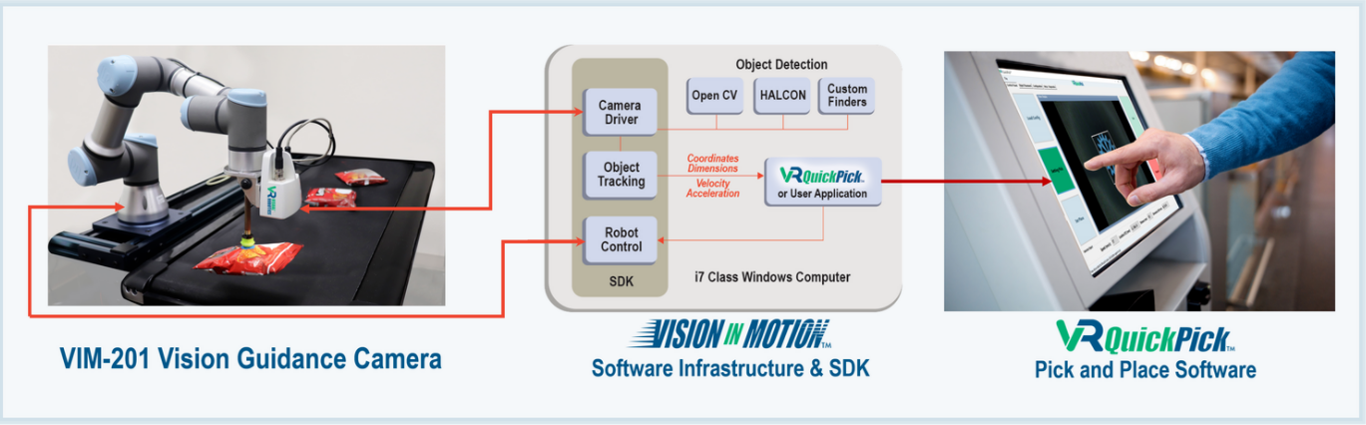
Tele manipulator robots today!
Robots in factories today also use 3D Vision Guidance System. This system can assist the robot to recognize objects to pick and place them even when they are moving. This disruption in technology can bring rapid improvements to factory productions in the future!

Slide 13
THANK YOU!

